Slide 1
An Intelligent AI-Based System for Personalized Placement Preparation and Skill Gap Analysis
Student Details:
1)Joyal Binsu(2362094)
2)Aiswarya K V(2362019)
3)Nihal Gireesh(2362120)
4)Pulikanti Gowtham Roy(2362135)
Guided By: Prof Chaitra PC

Slide 2
Agenda
Abstract
Problem Statement and Objectives
System Architecture
Literature Review / Background Study
Hardware and Software Requirements
Key Technical Implementation
Practice Modes and Answer Evaluation
Flowchart
Security and Reliability
Module Implementation Status
Testing and Validation Results
Product Walkthrough (Screenshots)
Timeline
Key Risks and Next Steps
Conclusion
References

Slide 3
Abstract
Prepwise is an AI-driven web platform that prepares students for campus placements and technical interviews.
Parses the student's resume (PDF / DOCX) into a structured profile of skills, education, projects and internships.
Offers three practice modes: resume-based Interview questions, topic-wise Technical questions and live DSA coding, generated by an LLM with a verified question bank as fallback.
Scores every answer instantly using concept rubrics (synonyms, partial credit, meaning similarity) plus AI grading, and returns specific feedback with a model answer.
Tracks topic-wise proficiency with a Bayesian, recency-weighted metric to reveal real skill gaps and recommend what to practise next.
Security-audited and hardened: verified accounts, sandboxed code execution and protected data.

Slide 4
Problem Statement and Objectives
Problem Statement
Objectives
To build a personalized candidate profile by analyzing resumes, academic records, and project details.
To generate and evaluate adaptive technical interview questions while providing instant, constructive feedback.
To identify skill gaps through performance analysis and recommend targeted learning resources for improvement.
Most existing placement-preparation tools offer generic question banks, resume checkers, or standard mock-interview simulators that do not account for a student's actual academic record, project experience, or current skill level. As a result, students often practice with material unrelated to their own profile, leading to unfocused preparation, no visibility into individual weak areas, and no personalized path for improvement.

Slide 5
System Architecture
Input: resume (PDF / DOCX) uploaded by the candidate; details reviewed and edited on a Verify Profile page
Module 1 — Profile Parser: sandboxed text extraction (pdfplumber / python-docx) + rule-based NLP and skills taxonomy → structured candidate profile
Module 2 — Question Generator: Groq LLM (Llama 3.3 70B) with output validation; fallback to a curated bank (74 technical, 12 behavioural, resume templates) → Interview & Technical questions
Module 3 — Evaluation Engine: concept rubric (synonyms, typo tolerance, partial credit) + TF-IDF meaning similarity + AI grader → score and feedback; DSA code judged in a Docker sandbox
Module 4 — Analytics & Recommender: Bayesian, recency-weighted proficiency per topic → weak areas and targeted practice links
Module 5 — Dashboard: Flask + Jinja2 web UI ⇄ PostgreSQL (Supabase) with SQLite fallback; email-verified accounts

Slide 6
Literature Review / Background Study
Existing System | Methodology | Research Gap / Limitations | How the Proposed System Addresses the Gap | Future Scope
Research on the AI Evaluation and Matching System for Automatic Text Recognition, Feature Information Extraction and Resume Based on Artificial Intelligence (IEEE, 2024) | Uses OCR, NLP, and AI algorithms to extract resume information and match candidates with job requirements. | Focuses only on resume screening and candidate-job matching. No interview preparation, coding evaluation, or personalized learning. | The proposed system extends resume analysis by incorporating academic performance and project details to generate personalized interview questions, evaluate responses, and recommend learning paths. | Integrate adaptive interview preparation, coding assessment, and personalized learning recommendations.
A RAG-based Personal Placement Assistant System using Large Language Models for Customized Interview Preparation (IEEE, 2024) | Uses Retrieval-Augmented Generation (RAG), ChromaDB, embeddings, and Gemini LLM to analyze resumes and generate domain-specific interview questions. | Provides limited performance analytics and weak-area tracking. Focuses mainly on question generation. | Adds detailed answer evaluation, adaptive difficulty levels, weak-area identification, and personalized topic recommendations. | Enhance performance analytics, continuous skill-gap tracking, and adaptive question difficulty.

Slide 7
Literature Review / Background Study
Existing System | Methodology | Research Gap / Limitations | How the Proposed System Addresses the Gap | Future Scope
AI-Powered Interview Preparation System: Integrating Resume Analysis, HR Simulation, and Technical Skill Assessment (SSRN, 2025) | Combines resume analysis, NLP, speech recognition, CNN-based emotion detection, and mock HR interviews. | Primarily evaluates HR interview performance and communication skills. Limited technical coding assessment. | Includes technical programming interviews, code evaluation, and personalized improvement suggestions based on candidate performance. | Extend to real-time coding interviews, automated code evaluation, and personalized technical learning paths.
AI-Powered Resume Analyzer and Interview Preparation System (IJRASET, 2025) | Integrates NLP, ML, and LLMs for resume parsing, skill extraction, job-role matching, and mock interviews. | Provides limited performance analytics and weak-area tracking. Focuses mainly on question generation. | Adds detailed answer evaluation, adaptive difficulty levels, weak-area identification, and personalized topic recommendations. | Incorporate adaptive assessments, detailed performance analysis, and long-term progress tracking

Slide 8
Literature Review / Background Study
Existing System | Methodology | Research Gap / Limitations | How the Proposed System Addresses the Gap | Future Scope
Artificial Intelligence in Career Counseling: A Test Case with ResumAI (arXiv, 2023) | Uses conversational AI to review resumes and provide career guidance through automated suggestions. | Focuses on resume improvement rather than interview preparation or technical skill assessment. | Extends beyond resume review by generating technical interview questions, evaluating answers, and identifying skill gaps | Expand beyond career guidance to include technical interview preparation and coding skill evaluation.
AI Hiring with LLMs: A Context-Aware and Explainable Multi-Agent Framework for Resume Screening (arXiv, 2025) | Employs multiple LLM agents with Retrieval-Augmented Generation (RAG) for resume extraction, evaluation, and explainable candidate scoring | Designed for recruiters and hiring organizations rather than students preparing for interviews. | Focuses on student-centric interview preparation with adaptive assessments and personalized feedback instead of recruitment automation. | Develop student-centric interview preparation with personalized feedback and skill development.

Slide 9
Literature Review / Background Study
Existing System | Methodology | Research Gap / Limitations | How the Proposed System Addresses the Gap | Future Scope
Adaptive LLM-Based Tutoring System for Coding Interview Preparation and Automated Code Evaluation (2025) | Uses Large Language Models to generate coding problems, evaluate submitted code, and provide adaptive tutoring. | Does not consider resumes, academic records, or project experience while personalizing assessments. | Generates coding questions using the complete candidate profile, resulting in more targeted interview preparation. | Integrate resume, academic, and project analysis for more personalized interview preparation.
Layout-Aware Parsing Meets Efficient LLMs: A Unified Framework for Resume Information Extraction and Evaluation (arXiv, 2025) | Combines layout-aware document parsing with efficient LLMs for accurate resume information extraction and evaluation | Concentrates on resume parsing accuracy without interview preparation or educational recommendations. | Utilizes parsed resume information as the foundation for adaptive interview generation, answer evaluation, and personalized learning. | Combine resume parsing with interview generation, response evaluation, and learning recommendations.

Slide 10
Literature Review / Background Study
Existing System | Methodology | Research Gap / Limitations | How the Proposed System Addresses the Gap | Future Scope
AI-Based Resume Analyzer and Interview Simulator (2025) | Uses NLP for resume parsing, machine learning for role mapping, and adaptive interview simulation with AI-generated feedback. | Limited integration of academic performance and project-based assessment. | Incorporates multiple candidate attributes including academics, projects, and coding performance for holistic placement preparation. | Improve personalization using academic performance, project experience, and adaptive learning strategies.
AI-Driven Resume Parsing and Automated Interview Question Generation using NLP (2025) | Applies NLP to extract resume information and automatically generate interview questions based on candidate skills | Question generation is largely static and lacks adaptive evaluation or continuous learning recommendations. | Evaluates candidate responses, identifies weak concepts, adjusts future question difficulty, and recommends topics for improvement. | Add dynamic answer evaluation, skill-gap analysis, and continuous personalized learning recommendations.

Slide 11
Hardware and Software Requirements
Hardware Requirements
Software Requirements
Python 3.10+ with Flask and Flask-Login
Groq API (Llama 3.3 70B) for question generation and AI grading
pdfplumber and python-docx for resume parsing
scikit-learn (TF-IDF) for answer similarity scoring
PostgreSQL (Supabase) / SQLite for profiles and results
Docker Desktop for the sandboxed DSA code runner
HTML, CSS, JavaScript with Jinja2 templates
Git / GitHub, VS Code; pytest for automated testing
Personal computer / laptop with a minimum of 8 GB RAM (16 GB recommended)
Intel Core i5 processor (or equivalent) or higher
Minimum 10 GB of free storage space
Stable, high-speed internet connection for LLM API access
Standard webcam and microphone (for future mock-interview simulation features)

Slide 12
Key Technical Implementation
Tech Stack Used
Core Algorithms & Design Decisions
Resume parsing runs in an isolated, time-limited process and builds a structured profile.
Question generation is personalised by resume, chosen topic, weak areas and history; every LLM question is validated.
Answer evaluation blends a concept rubric, meaning similarity to a model answer and AI grading.
Proficiency uses Bayesian smoothing with recency weighting, so one lucky answer can't mark a topic strong.
AI-generated DSA problems are accepted only if their reference solution passes their own tests.
Modular architecture separates parsing, generation, evaluation, analytics and execution.
Language: Python 3.10+
Framework: Flask, Flask-Login, Jinja2
Frontend: HTML, CSS, JavaScript
Database: PostgreSQL (Supabase), SQLite fallback
Resume Parsing: pdfplumber, python-docx, rule-based NLP
AI / ML: Groq Llama 3.3 70B, scikit-learn TF-IDF
Analytics: Bayesian proficiency metric
Code Runner: Docker sandbox (no network, read-only)
Security: bcrypt, CSRF tokens, CSP, rate limits
Testing: pytest (184 tests) + validation suite

Slide 13
Practice Modes and Answer Evaluation
Three Practice Modes
How Answers Are Scored
Key concepts accept synonyms and alternative phrasings.
Small typos are tolerated; half-explained points earn partial credit.
Meaning similarity to a model answer rewards correct answers in the student's own words.
AI grader marks concept by concept and flags factual errors; blended 70 / 30 with the rubric.
Anti-gaming: keyword lists capped at 50%, question echo ignored, grader manipulation detected.
Feedback shows covered / partial / missing points, strengths, improvements and a model answer.
Interview: questions about the student's own projects, internships and skills, plus behavioural / HR (STAR) questions. Pick a specific project or internship.
Technical: core CS concepts across 11 topics (DSA, DBMS, OS, CN, OOP, System Design, Python, ML, Web). Pick a topic or 'Recommended' (weak areas first).
DSA: 57 verified coding problems with an in-browser editor, sample tests (Run) and hidden tests (Submit).

Slide 14
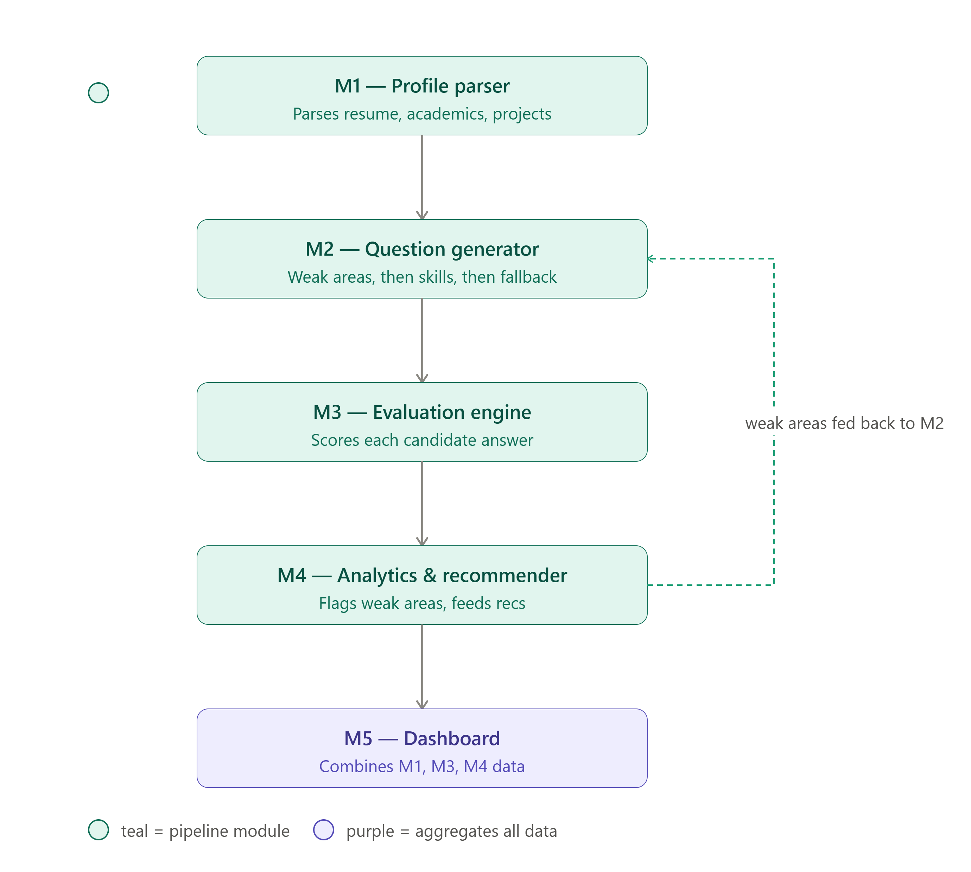
FlowChart

Slide 15
Security and Reliability
Security Audit
Key Protections
Email-verified accounts: bcrypt passwords, breached-password check, hashed one-time codes with attempt limits
CSRF tokens, strict Content-Security-Policy and security headers on every page
Every profile, question and problem is checked against its owner
Rate limits on login, codes, uploads, AI calls and code runs
Resumes parsed in a sandboxed process; submitted code runs only inside Docker
LLM prompts use server-side data only; AI output validated before use
A full security audit covering 25 areas (mapped to the OWASP Top 10) found 28 issues. All were fixed in four phases and re-verified by an independent adversarial review, 90+ security regression tests, dependency scanning (pip-audit) and static analysis (bandit, zero medium/high findings).

Slide 16
Module Implementation Status
Module | Owner | % | Status | Summary
M1 Profile Parsing | Joyal | 100% | Done | PDF/DOCX parsing into skills, education, projects and internships; sandboxed parser; edit and re-upload; resume feedback (field F1 0.977).
M2 Question Generation | Aiswarya | 100% | Done | Interview and Technical modes with topic picker; Groq LLM generation with validation; 74 technical + 12 behavioural questions + resume templates.
M3 Evaluation & Feedback | Nihal | 100% | Done | Concept rubric with synonyms, typo tolerance and partial credit; meaning similarity; AI grading; structured feedback; Docker DSA judge.
M4 Analytics & Recommendation | Gowtham | 100% | Done | Bayesian recency-weighted proficiency; weak / strong areas; recommendations linked to the right practice mode and topic.
M5 Dashboard & Integration | Gowtham | 100% | Done | Full flow live on PostgreSQL (Supabase); email-verified auth, password reset, display names; security-audited.

Slide 17
Testing and Validation Results
Area | Result | Target | Status | What was measured
Resume Parsing | F1 0.977 | ≥ 0.80 | Pass | Field-level macro-F1 on labelled resumes (PDF and DOCX); internships and projects F1 1.00.
Answer Scoring | 94.7% | ≥ 80% | Pass | Correct score band on 38 realistic hand-written answers (synonyms, typos, partial). Old keyword method: 36.8%.
Scoring Consistency | ρ = 0.951 | ≥ 0.80 | Pass | Spearman correlation between answer quality and score on 345 cases; MCQ accuracy 100%.
DSA Code Judge | 100% | 100% | Pass | Correct verdict for correct, wrong, crashing and slow solutions on all 57 problems.
Skill Metric | 0% false flags | — | Pass | No false 'weak' flags after one attempt (simple average: 20.3%); error reduced 33%.
Security & Integrity | 11 / 11 | 11 / 11 | Pass | Answer keys never sent to the browser, forged scores rejected, other users' data blocked.
Automated Tests | 184 | All pass | Pass | Unit, end-to-end, security regression and practice-mode tests (pytest).

Slide 18
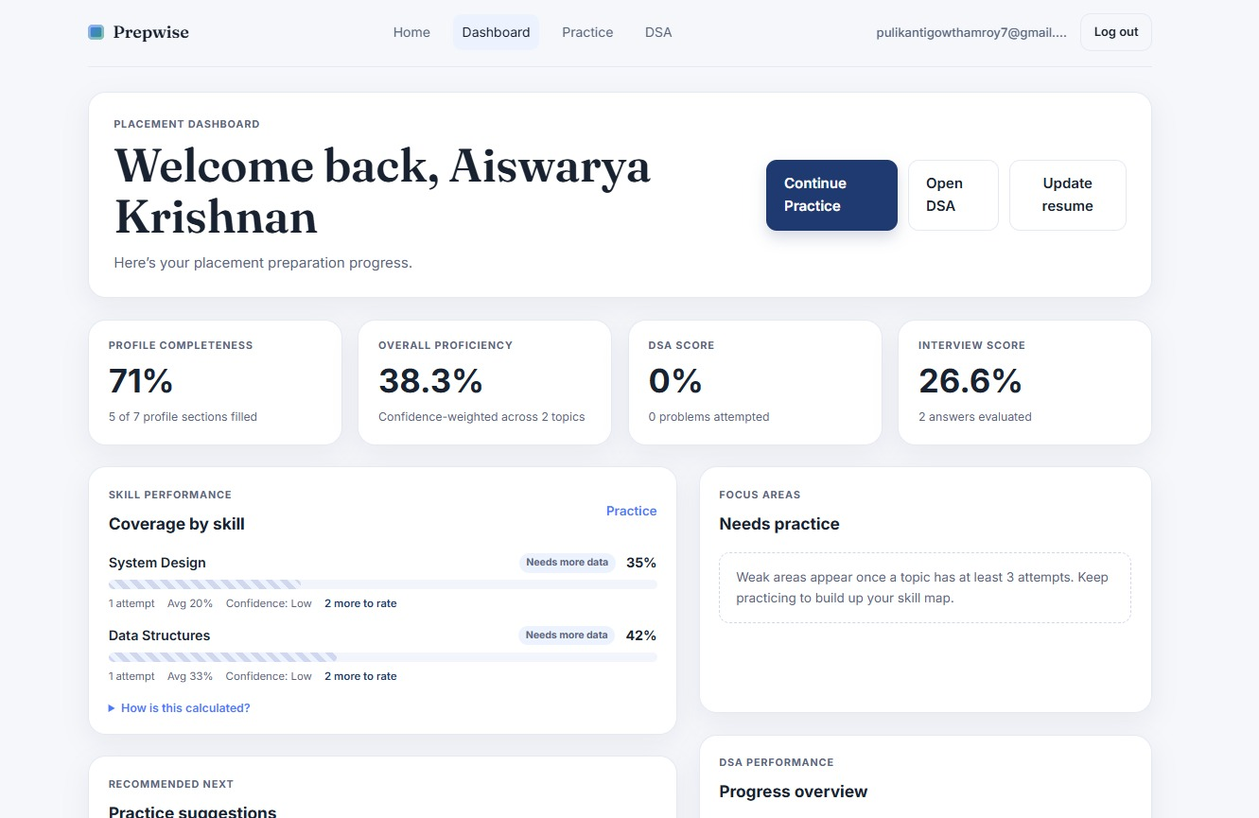
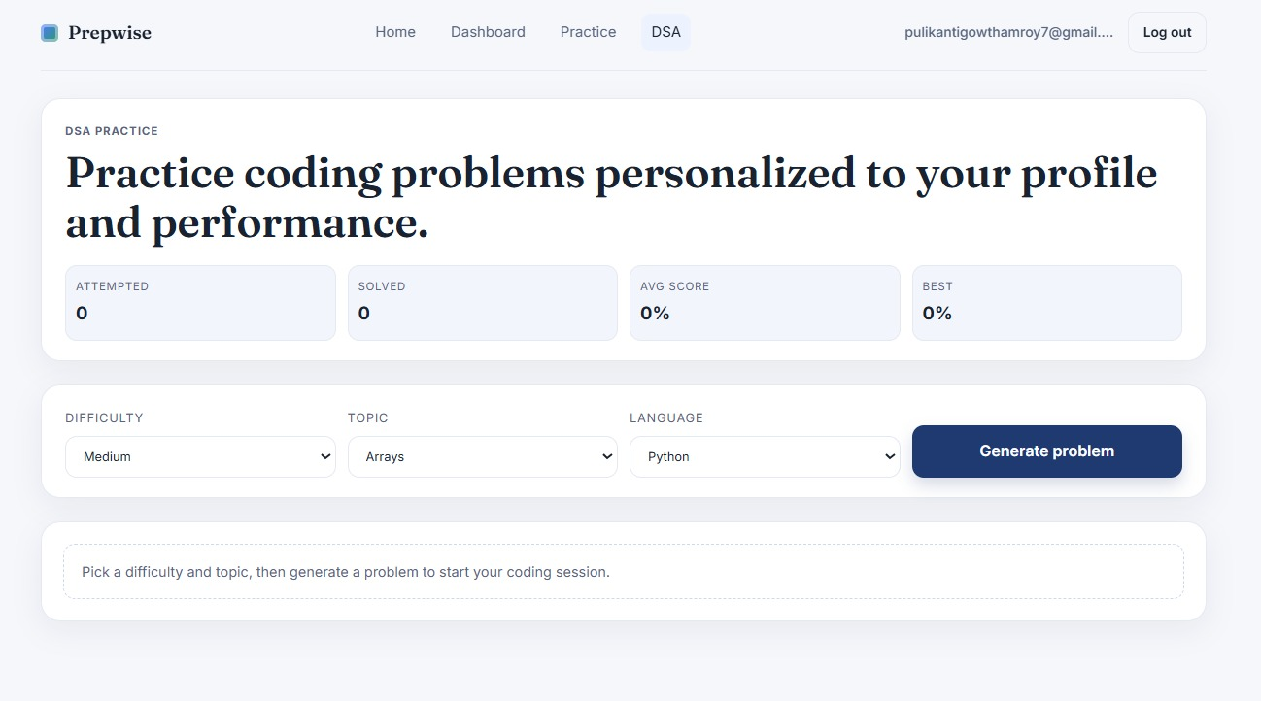
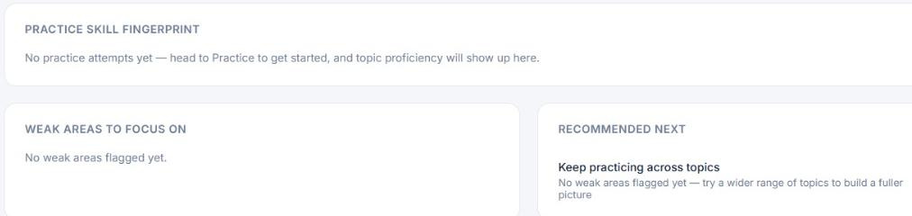
Product Walkthrough
Live, working end-to-end on real data — upload → profile → practice → dashboard
Auto-generated candidate dashboard (M5)
Adaptive practice question (M2 + M3 scoring)
Every screen renders from real database records, not mock data
Skills, projects and internships are parsed directly from the uploaded resume (M1)
Questions come from the LLM, with a validated question bank and resume templates as fallback (M2)
Answers are scored by the upgraded rubric + AI grading (M3)
Skill fingerprint & weak areas (M4)

Slide 19
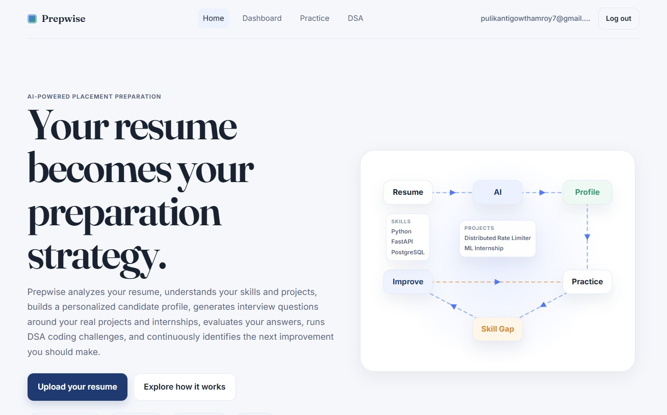
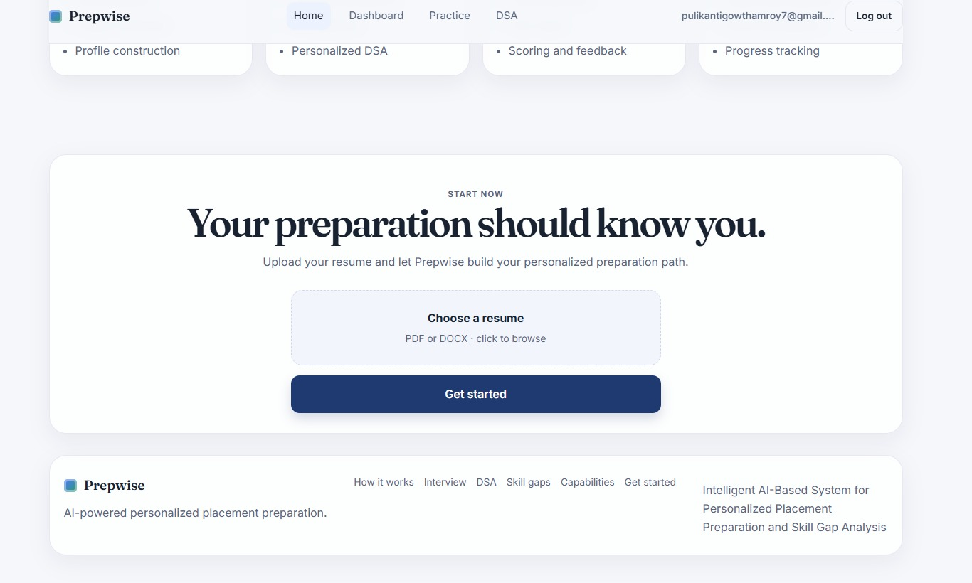
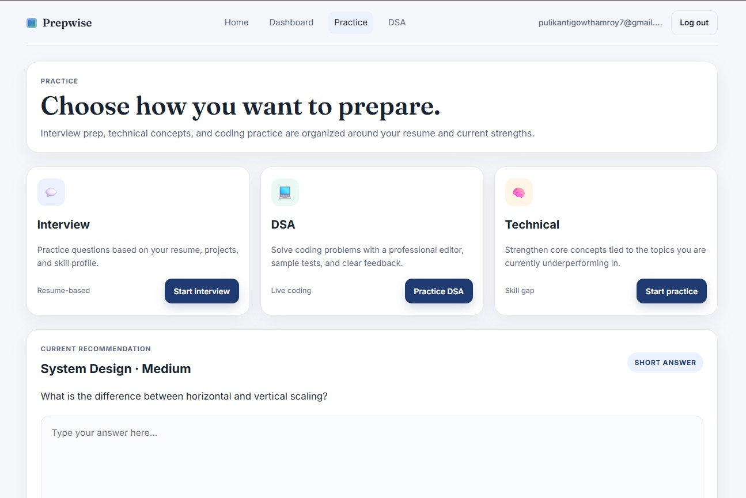
Dashboard Overview

Slide 20
Dashboard Overview

Slide 21
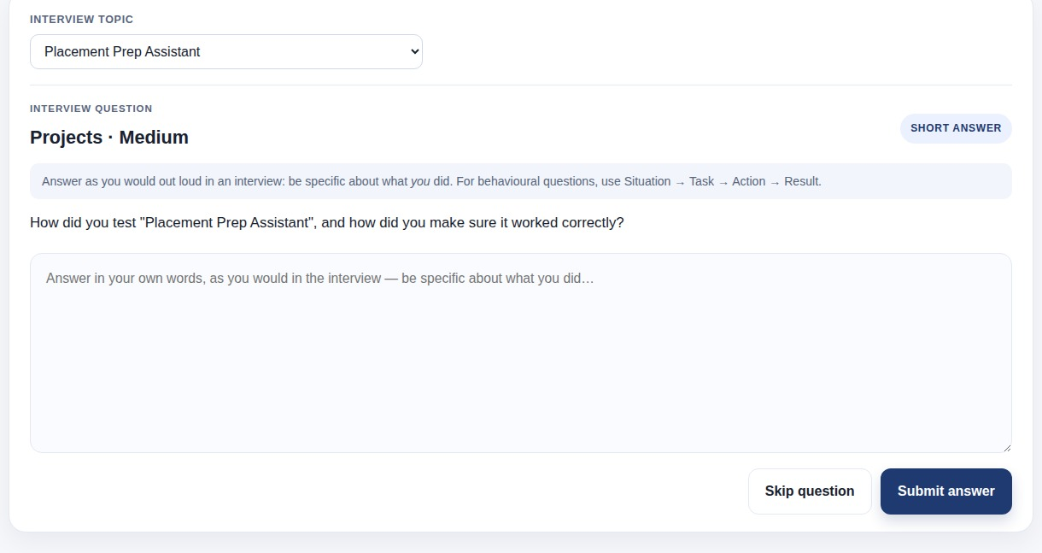
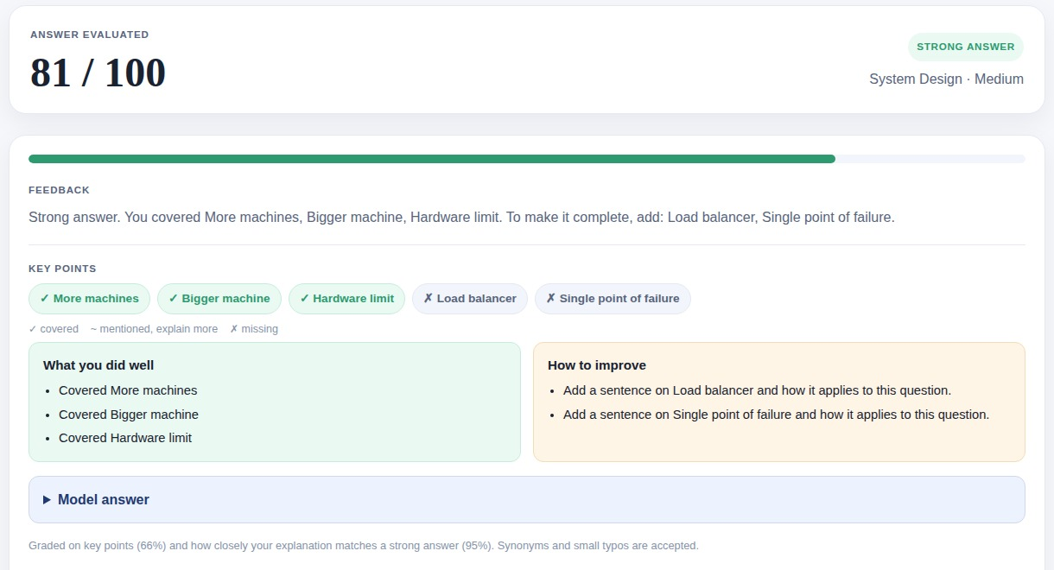
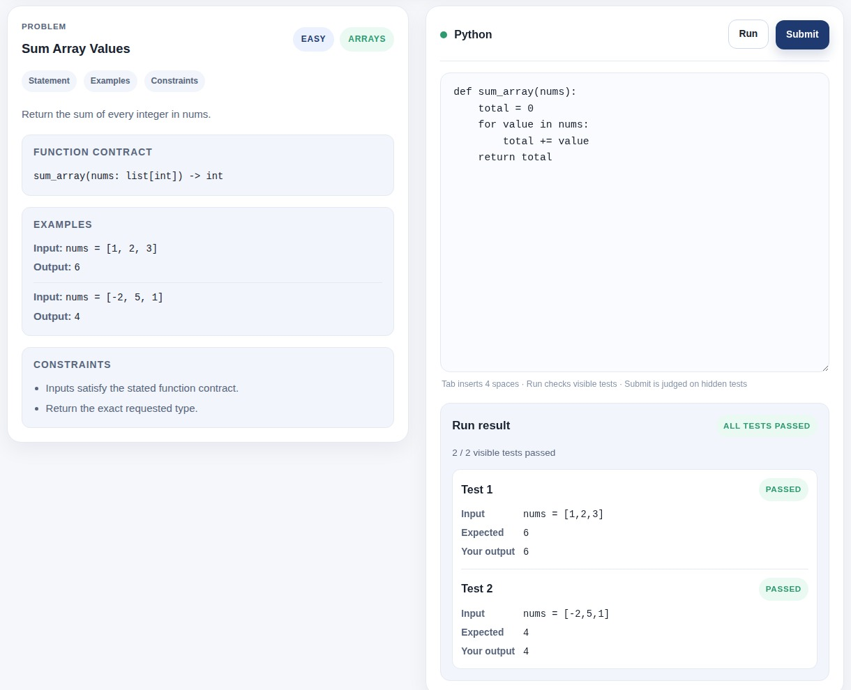
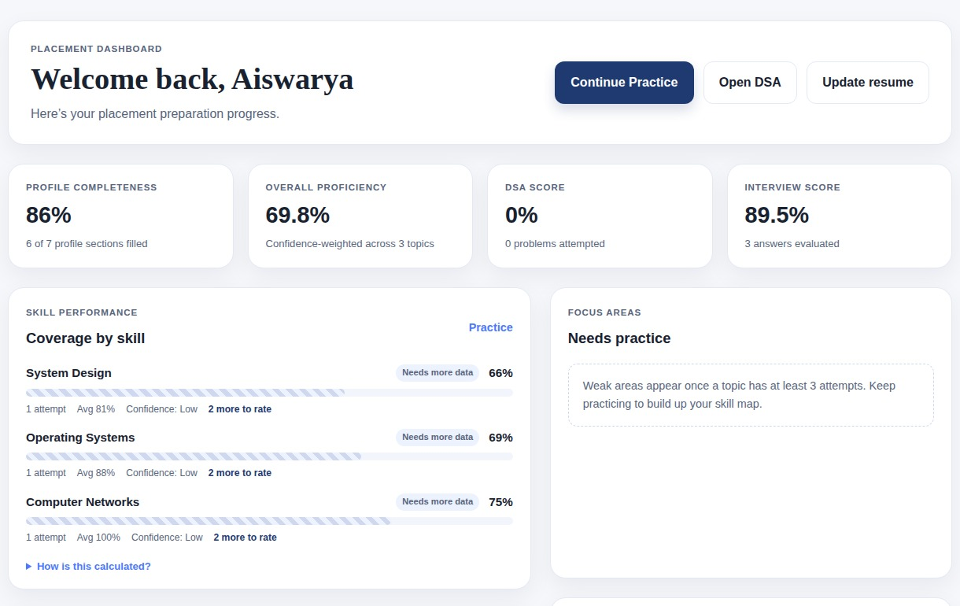
Product Walkthrough — Latest Features
Interview mode with topic picker (M2)
Feedback: key points, strengths and next steps (M3)
DSA practice with live test results
Dashboard: proficiency and focus areas (M4, M5)

Slide 22
Timeline
Week 1-2
Week 4-5
Week 8-10
Week 11
Literature Review &
Requirement Analysis
M1 — Resume /
Profile Parsing
M3 — Evaluation &
Feedback (High Risk)
Integration &
End-to-End Testing
Week 3
Week 6-7
Week 9-10
Week 12
System Design &
Architecture Planning
M2 — Question
Generation
M4 — Analytics &
Recommendation
Final Documentation
& Demo Prep
Done
On Track
At Risk
Upcoming
Status as of this review: all five modules are implemented, integrated and tested; final documentation and demo preparation are in progress.

Slide 23
Key Risks and Next Steps
Key Risks and Mitigations
Next Steps
Agentic mock-interview mode with multi-turn follow-up questions
Voice answers with speech-to-text for interview practice
More languages in the DSA sandbox (Java, C++)
Learning resources linked to each weak topic
Cloud deployment behind HTTPS with shared rate limits
User study with students to measure preparation outcomes
LLM availability and cost → validated question-bank fallback and per-user daily AI limits.
AI grading inconsistency → blended with a deterministic rubric and validated on labelled answers.
Untrusted resumes and code → sandboxed parser and Docker code runner.
Database or network outages → clear startup errors and an optional local SQLite fallback.

Slide 24
Conclusion
Prepwise turns a student's own resume into a personalised preparation plan: interview, technical and coding practice in one place.
The evaluation engine scores answers fairly, accepting the student's own wording, and explains exactly what to improve.
Skill-gap analytics make weak areas visible and link directly to targeted practice.
All five modules are implemented, integrated and validated with measurable results (94.7% scoring accuracy, 100% code-judge accuracy).
The system has been security-audited and hardened, ready for real student use.

Slide 25
References
[1] "AI Evaluation and Matching System for Automatic Text Recognition, Feature Information Extraction and Resume Based on Artificial Intelligence," IEEE, 2024.
[2] "A RAG-Based Personal Placement Assistant System Using Large Language Models for Customized Interview Preparation," IEEE, 2024.
[3] "AI-Powered Interview Preparation System: Integrating Resume Analysis, HR Simulation, and Technical Skill Assessment," SSRN, 2025.
[4] "AI-Powered Resume Analyzer and Interview Preparation System," IJRASET, 2025.
[5] "Artificial Intelligence in Career Counseling: A Test Case with ResumAI," arXiv, 2023.
[6] "AI Hiring with LLMs: A Context-Aware and Explainable Multi-Agent Framework for Resume Screening," arXiv, 2025.
[7] "Adaptive LLM-Based Tutoring System for Coding Interview Preparation and Automated Code Evaluation," 2025.
[8] "Layout-Aware Parsing Meets Efficient LLMs: A Unified Framework for Resume Information Extraction and Evaluation," arXiv, 2025.
[9] "AI-Based Resume Analyzer and Interview Simulator," 2025.
[10] "AI-Driven Resume Parsing and Automated Interview Question Generation Using NLP," 2025.

